Slide 1
Erin’s Law
Passed in 2015:
Established Governor’s Task Force on Child Abuse Prevention

Slide 2
OUTLINE
General Information
Why Report?
Who Must Report?
Know the Signs
Reporting
Outcomes

Slide 3
Erin’s Law
K-12 public schools to establish a child sexual abuse prevention instructional program for students in Grades K-12 and a comprehensive staff training program regarding the mandate reporting of known or suspected child abuse or neglect for all school employees and volunteers, who have significant contact with students.
Information about Erin Merryn: http://www.erinmerryn.net/

Slide 4
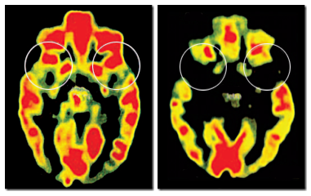
Why Report?
-Your help is needed to ensure that abused or neglected children receive adequate protection and services.
-Legal Obligation
-Occurrence of child abuse/neglect can have both short-term and long-term effects .
Image of Brain:
Image on left side is a child NOT abused and image on right is image of child abused.

Slide 5
Who Must Report?
Under the Alabama Child Abuse Reporting Act, anyone may report suspected child abuse or neglect to a “duly constituted authority,” primarily DHR and law enforcement, when it is suspected that a child is being abused or neglected. However, certain professionals must, by law, report suspected child abuse or neglect – in other words, they are mandated reporters. Note that the Code of Alabama § 26-14-1 (1975) defines a child as a person under the age of 18 years.
It is a Class B misdemeanor (punishable by a sentence of up to six months imprisonment or a fine of not more than $500.00) when a mandated reporter chooses not to report suspected child abuse/neglect. To fulfill the mandate, reports must be made directly to DHR or law enforcement in your county as described in the “Reporting” section of this training.

Slide 6
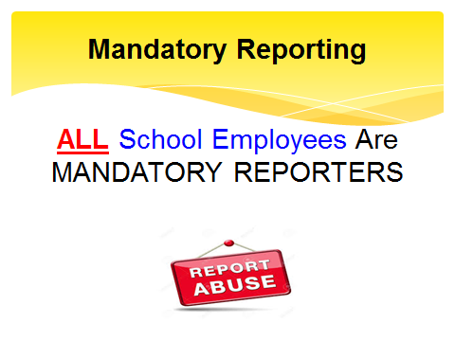

Slide 7
Know the Signs - Children who are physically abused may:
Be self-destructive, aggressive, or withdrawn
Run away frequently
Explain their injuries in strange or inconsistent ways
Seem afraid of adults, including parents or guardians
Intentionally hurt animals
Report that an adult is hurting them

Slide 8
Know the Signs - Sexually abused children may:
Act seductive or engage in inappropriate sex play
Show great worry for their siblings
Gain or lose a large amount of weight
Attempt suicide
Feel threatened by physical contact
Have difficulty walking or sitting
Have nightmares or wet the bed
Become pregnant or contract a venereal disease
Run away from home

Slide 9
Reporting
A report is a statement that someone is concerned for a child’s welfare.
File your report with the County DHR office where the child resides.
You can report by phone, by fax, or in person.
Reports submitted by telephone must be followed by a written report.
Contact information for all County DHR offices can be accessed online at: http://www.dhr.alabama.gov/counties/county_select.aspx
Dekalb County Contact Information: http://www.dhr.alabama.gov/counties/county_results.aspx?id=DeKalb

Slide 10
Outcomes
The final decision about whether child abuse/neglect occurred is made by DHR.
The mandated reporter who filed the report shall receive written notification of the disposition, but will not receive information regarding the actual investigation.

Slide 11
Link to slideshow from the State Department of Child Abuse and Neglect Prevention
https://www.bcbe.org/cms/lib/AL01901374/Centricity/Domain/3910/Mandatory%20Reporting.pdf

